Slide 1
Sticker Detection

Slide 2
Overview
Get ROI
Mean Shift Segmentation
Score Design
Bottom-up Method
Add Location Constraints
Final Detection
Results

Slide 3
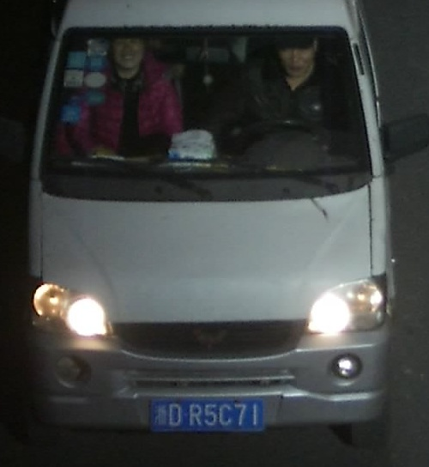
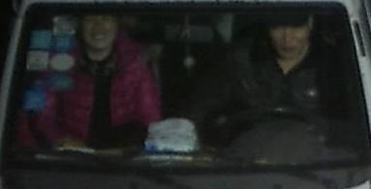
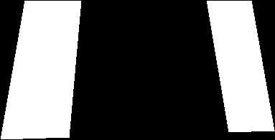
Get ROI
Locate the windshield from .ini file and use a binary mask to represent the ROI.

Slide 4
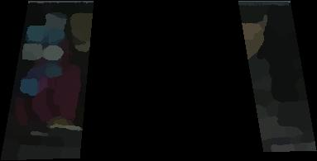
Mean Shift Segmentation
Mean Shift Segmentation

Slide 5


Score Design
Bounding Box Estimation for Each Block
  Use parallelogram to represent the block shape.
  Determine the major and minor axes angle by using the orientation of the windshield.
  Iteratively decrease the distance from the boundary points of the block to the bounding box edges.
  For example,
Block
Bounding Box

Slide 6
Score Design
Overlapping ratio score s_{o}
  Overlapping ratio between block area and bounding box
Area size score s_{a}
  Area size of the bounding box
Shape score s_{r}
  The ratio score between major and minor axis-length of the bounding box
Combined score s_{t}
s_{t} = s_{o}s_{a}s_{r}
  All the scores are in [0, 1].

Slide 7
Score Design
Color Score s_{c}(i,j)
  Represents the color distance between the block i and its neighbor block j.
  High color score corresponds to low color distance.
  The score is also between [0, 1].

Slide 8
Bottom-up Method
Goal: The segmentation with mean shift is not accurate due to the low resolution of the input image. We want to merge similar blocks after mean shift.
Two cases:
  Merged block has a much higher combined score than the individual blocks.
  Two adjacent blocks has very similar color.
We want to merge the blocks that are in these two cases.

Slide 9

Bottom-up Method
Set the object function as
where i is the current block; j is the neighbor of the block i; s_{ti} and s_{tj} are the combined scores of the block i and block j; s_{c}(i, j) is the color score between block i and j; is the combined score after we merge the block i and j; is the neighbor index we choose to merge with block i.

Slide 10

Add Location Constraints
Some facts of the sticker locations
  Most stickers are in the top left and top right regions.
  If there are multiple stickers, the centers of the stickers are always in a line along with the windshield orientation.
  The stickers are always not far from each other.
  For examle,
The center of the stickers are marked in the red circle

Slide 11
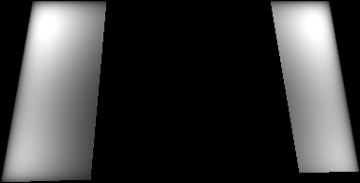
Add Location Constraints
We can use those facts as the prior information.
Construct the location weight w_{l}
brighter area represents higher weights

Slide 12
Add Location Constraints
Distance Weight w_{d}(i, j)
  The weight of distance between i and j block centers. Higher weight represents lower distance.
Angle Weight w_{a}(i, j)
  The weight of angle between i and j block centers. We give a higher weight if the angle between two centers is along with the windshield orientation.

Slide 13
Final Detection
Construct the matrix H
  For each element in H,
  H_{i,j} = sqrt(s_{ti}s_{tj}w_{l}(i)w_{l}(j)w_{d}(i, j)w_{a}(i, j))
  where i and j represents the block index. All the scores and weights are defined in previous slides.
Sum the column of H
  We get a uniform score for each block after summation.
  Choose the block above a certain threshold.

Slide 14
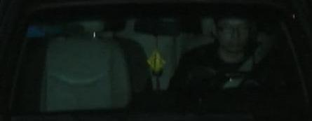
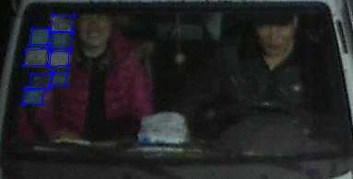
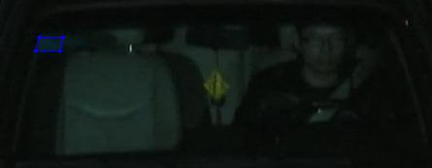
Results

Slide 15
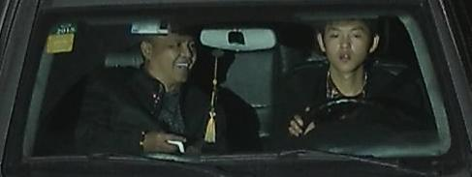
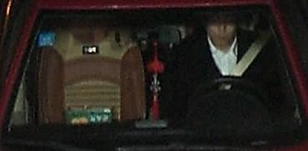
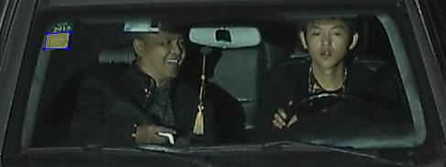
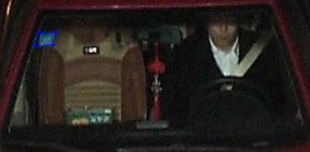
Results

Slide 16
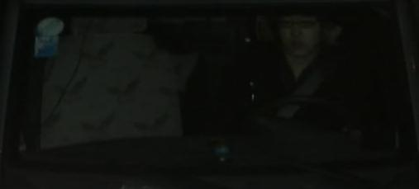
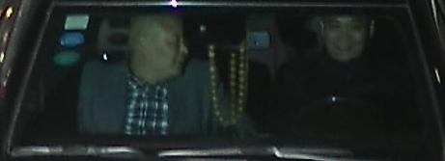
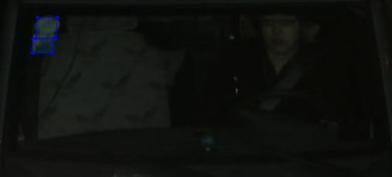
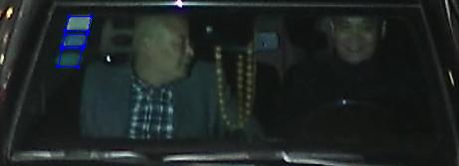
Results

Slide 17
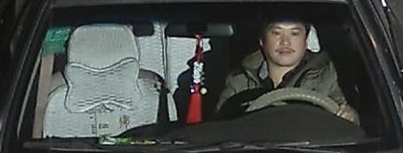
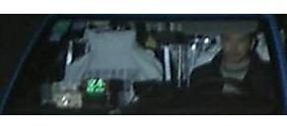
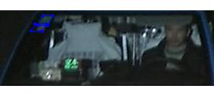
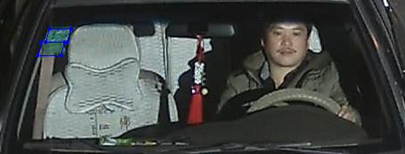
Results

Slide 18
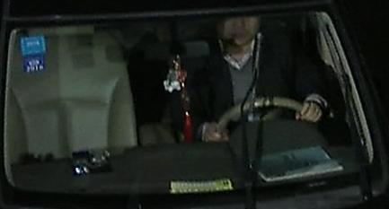
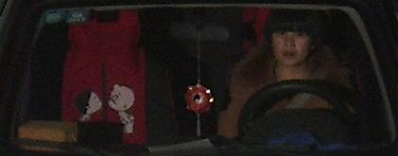
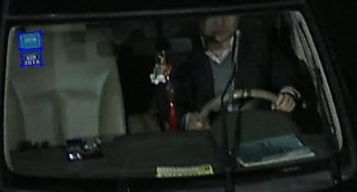
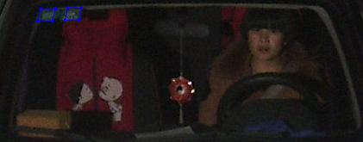
Results

Slide 19
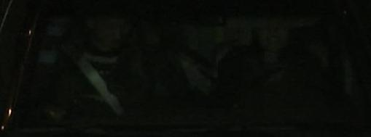
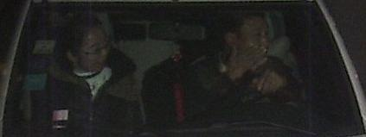
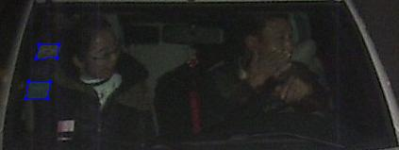
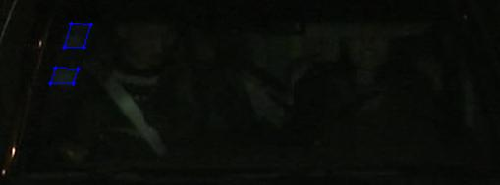
Results

Slide 20
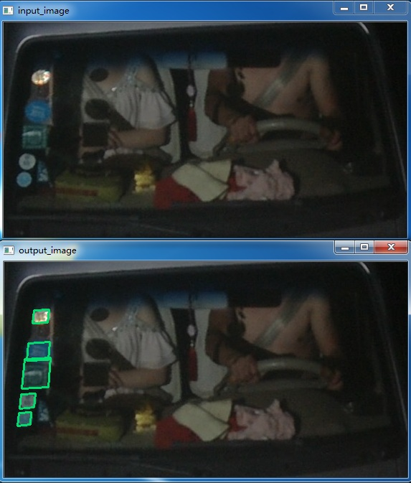
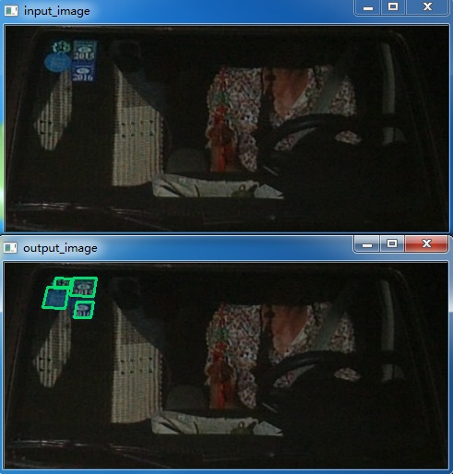
Results on the new dataset

Slide 21
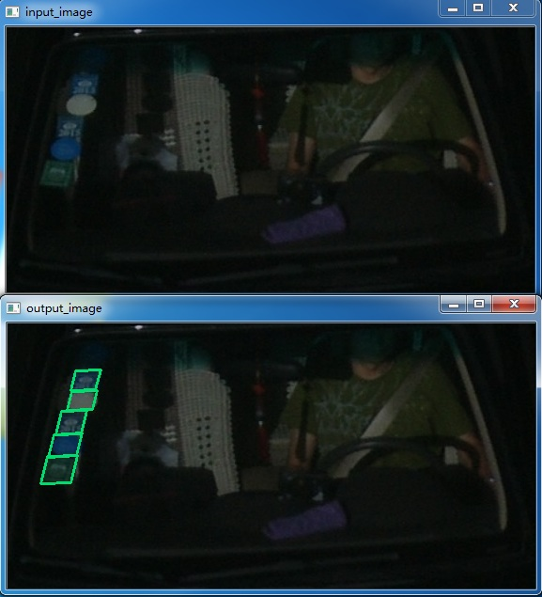
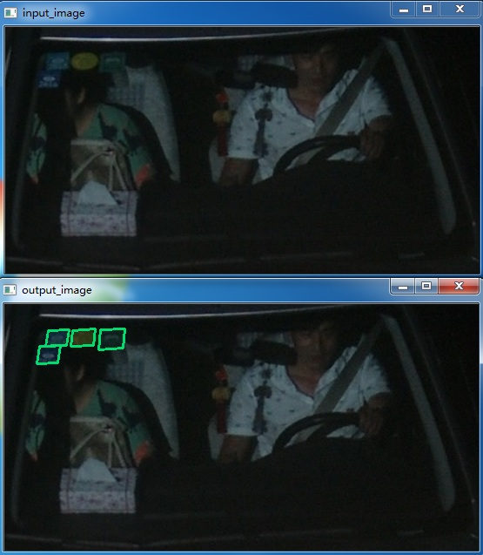
Results on the new dataset

Slide 22
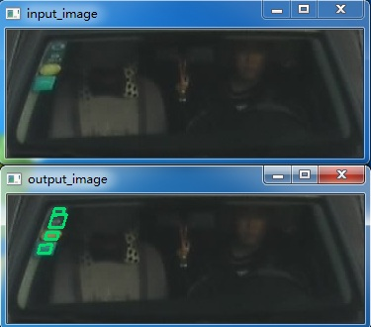
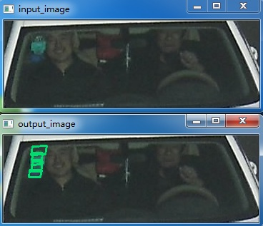
Results on the new dataset

Slide 23
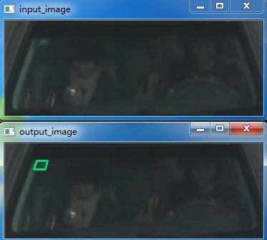
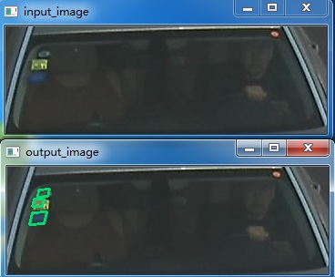
Results on the new dataset

Slide 24
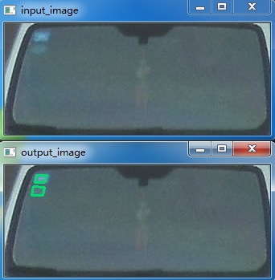
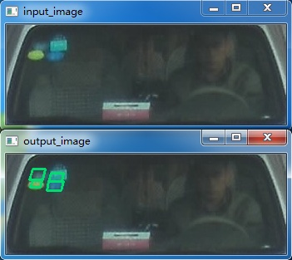
Results on the new dataset

